Slide 1
CMSC 304
Common Lisp Introduction
Claire Sparks

Slide 2
Programs as Functions
A program is a description of specific computation
If we ignore the “how” and focus on the result, or the “what” of the computation, the program becomes a virtual black box that transforms input into output
  A program is thus essentially equivalent to a mathematical function
Function: a rule that associates to each x from set of X of values a unique y from a set Y of values

Slide 3
Programs as Functions
In mathematical terminology, the function can be written as y=f(x) or f:X→Y
Domain of f: the set X Range of f: the set Y
Independent variable: the x in f(x), representing any value from the set X
Dependent variable: the y from the set Y, defined by y=f(x)
In terms of a function, x represent the parameters and y represents the returned values
x is input and y is output

Slide 4
Programs as Functions
Need to distinguish function definition from function application:
  Functional definition: describes how a value is to be computed using formal parameters
  Functional application: a call to a defined function using actual parameters, or the values that the formal parameters assume for a particular computation
  Ex: square (x) = x * x (this is a function definition) If apply 2 to x, then this is a function application.

Slide 5
Programs as Functions
Functional programming takes the mathematical approach to concept of variable.
  Variables are bound to values not memory locations and their values cannot change.
  There is no concept of assignment, which can reset the value of a variable
  Lack of assignment makes traditional loops impossible!

Slide 6
Programs as Functions
The property where the value of any function depends only on the values of its arguments is called referential transparency.
  Ex: gcd verses rand
  There is no notion of state, since there is no concept of memory locations with changing values – referred to as value semantics
Functions can be manipulated in arbitrary ways and be general language objects and viewed as values themselves which can be computed by other functions or used as parameters to functions
  Functions are first-class data values

Slide 7
Programs as Functions
Composition: essential operation on functions
  A function takes two functions as parameters and produces another function as its returned value
In math, the composition operator o is defined:
If f:X→Y and g:Y→Z, then g o f:X→Z is given by
(g o f)(x) = g(f(x))
Higher-order functions: function that have parameters that are functions themselves or that produce a result that is a function

Slide 8
Functional Programming
Functional Programming: A programming paradigm which treats computation as the evaluation of mathematical functions
An easy example of a functional language is spreadsheet calculation
  Data is stored in cells and transformations take place from cell to cell
  Ultimately producing a result
This paradigm is different from the imperative paradigm
  No explicit sequence of steps, just transformations (which may have dependencies)
  No memory side effects
Side Effects: A change in the value of a variable that persists beyond the local scope

Slide 9
Functional Programming
Without side effects means:
  If the result of a function is not used, it can be removed from the program
  Same parameters passed to a function always produce the same results
  If there is no data dependency between functions, the functions can be evaluated in any order
    Implicitly parallelizable, unlike imperative languages
    In our multicore world, implicit parallelization is extremely valuable!!
Notes:
Keep your rant about this to 10 min max!!

Slide 10
Common Lisp: A Dialect of Lisp
Lisp (LISt Processing): first language that contained many of the features of modern functional languages
Features included:
  Uniform representation of programs and data using a single general structure: the list
  Definition of the language using an interpreter written in the language itself
  Automatic memory management by the runtime system
In this course we will use Common Lisp, a direct descendent of Lisp
Notes:
Lacked standards

Slide 11
LISP BNF
s_expression = atomic_symbol |"(" s_expression "." s_expression ")" | list
list = "(" s_expression < s_expression > ")"
atomic_symbol = letter atom_part
atom_part = empty | letter atom_part | number atom_part
letter = "a" / "b" / " ..." / "z"
number = "1" / "2" / " ..." / "9"
empty = " "

Slide 12
Elements of Common Lisp
All programs and data in Common Lisp are considered S-expressions
There are two types of S-expressions:
  Atoms: literal constants such as strings, numbers, and booleans
  Lists: sequence of zero or more expressions separated by spaces and surrounded by parentheses
  Ex: ( 3 4 5 )
  ("abc" 7 (9 10) )

Slide 13
Common Lisp Data Structures
The list data structure supports:
  structured types for vectors (one-dimensional arrays)
  strings
It also represents:
  A sequence
  A record
  Or any other structure
Notes:
Basically, we can build more complex data structures out of lists

Slide 14
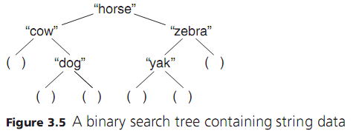
Common Lisp Data Structures
Example: a list representation of a binary search tree
  (list "horse" (list "cow" () (list "dog" () ()) ) (list "zebra" (list "yak" () ()) () ) )
A tree node is a list of three items

Slide 15
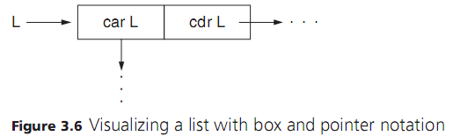
Common Lisp Data Structures
Lists are composed of cons cells
A cons cell is a pair of values: the car and the cdr
  List L is a pointer to a cons cell, with the car storing the first value and the cdr storing a pointer to the next cons cell
  Shown with a box and pointer notation:
Notes:
The singly linked list is your god.
The two values in a cons cell are called the CAR and the CDR after the names of the functions used to access them. At the dawn of time, these names were mnemonic, at least to the folks implementing the first Lisp on an IBM 704.

Slide 16
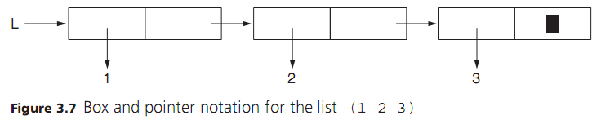
Common Lisp Data Structures
Box and pointer notation for a simple list (1 2 3)
  Black rectangle in the end box stands for the empty list ( )
  In lisp, the empty list represents NIL

Slide 17
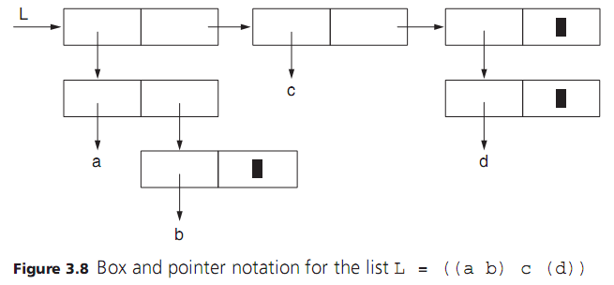
Common Lisp Data Structures

Slide 18
Elements of Common Lisp - Evaluation
All programs and data in Common Lisp are considered S-expressions
Evaluation rule: the meaning of a S-expression
The standard evaluation rules for atoms are:
  Atomic literals evaluate to themselves
    9 evaluates to 9
    "abc" to "abc"
    etc
  Atomic variables evaluate to the value they’re bound to
    Atomic variables are looked up in the variable namespace and replaced by the values found there
    A namespace in Common Lisp is a runtime environment that associates identifiers with values
Notes:
Common Lisp actually has two namespaces. One for variables and another for operators

Slide 19
Elements of Common Lisp - Evaluation
The standard evaluation rules for lists are:
  To evaluate a list, the list must start with an atomic operator
  An atomic operator evaluates to either a function, a macro, or a special operator
    We will define discuss macros and special operators in later lectures
  If the atomic operator is a function, we evaluate the remaining elements of the list as either literals or variables and pass the resulting values to the specified function
    Ex: (+ 2 3) --> 5
  Thus, all lists must be written in prefix form
  Use applicative order evaluation – sublists evaluated first
    Ex: (* 3 (+ 2 3) (- 6 4) ) --> (* 3 5 2) --> 30

Slide 20
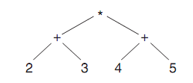
Elements of Common Lisp - Evaluation
Ex: (* (+ 2 3) (+ 4 5 ))
  Two additions are evaluated first, then the multiplication
  Answer: (* 5 9) → 45

Slide 21
Elements of Common Lisp - Evaluation
Ex: (/ (+ 2 3)) --> (/ 5) --> 1/5
  Addition is evaluated first, then the division
  Common Lisp supports real numbers and fractions!
Ex: (+ 5 6 7) --> 18
Ex: (/ 8) --> 1/8
Ex: (/ (+ 5 6 7) ) --> (/ 18) --> 1/18
Ex: (/ 8 2 2) --> 2
Ex: (+ "abc" "def")--> runtime error!
  The + function doesn‘t support string concationation
  Common Lisp is dynamically typed and type errors won‘t be detected until runtime

Slide 22
Elements of Common Lisp - Evaluation
Ex: (quote (1 2 3))
  quote is not a function but a special operator
    Special operators behave in ways functions can’t
    The quote special operator prevents the evaluation of a list s-expression
    quote is necessary here, because (1 2 3) can’t be successfully evaluated
      If evaluated, the list’s first element is assumed to be a function
      When no function named 1 is found, a runtime error is thrown
    But (quote (1 2 3)) evaluates to a list of three elements!
    (quote (1 2 3)) --> (1 2 3)
    Super useful, one common use is passing a list of data as an argument without the list trying to evaluate itself
  quote can also be written as '
  Ex: '(1 2 3)

Slide 23
Adding Identifiers
defvar
  Provides ability to make a new global binding of a variable visible in the top-level environment of Common Lisp
  (defvar identifier expr)
  Ex:
  (defvar *List* '("abc" 7 (9 10)))
*List* --> ("abc" 7 (9 10))
  defvar binds the identifier to the result of the expression
  *List* is the identifier for the list passed in as the expression

Slide 24
Common Lisp Data Structures
To use the list structure, need set of functions that operate on lists:
  car: returns the first element of the given cons cell, the head of our list
  cdr: returns the second element of the given cons cell, the rest of our list
  cons: builds new cons cell
  list: allows you to specify a list
If L is list (1 2 3)
  (car L) gives 1
  (cdr L) gives (2 3)
  (cons 4 L) gives (4 1 2 3)
  (list 1 2 3) gives ( 1 2 3)
Notes:
Car here takes behavior similar to C since L is bound to the first cell in 1, 2, 3
Car is value, CDR is sublist (everything after head).
REMEMBER EVERYTHING IS A SINGLY LINKED LIST
(cons 4 nil) gives you a list with one element
(defvar L (list 1 2 3))

Slide 25
Common Lisp Data Structures
Ex: (defvar *list* (list "abc" 7 (list 9 10) ))
(car *list*) "abc"
(cdr *list*) (7 (9 10))
(car (cdr *list*)) 7
(cdr (cdr *list*)) ((9 10))
(car (cdr (cdr *list*))) (9 10)
(cdr (cdr (cdr *list*))) NIL
(car (car (cdr (cdr *list*)))) 9
Notes:
As you've seen in previous chapters, global variables are conventionally named with names that start and end with *

Slide 26
Common Lisp Data Structures
Constructing a list using cons
Ex: (cons "abc" (cons 7 (cons (cons 9 (cons 10 () ) ) () ) ) )
  builds ("abc" 7 (9 10))
Empty list is represented with: ()
() is interchangeable with NIL

Slide 27
Common Lisp Data Structures
Pair vs list: cons
  (cons 1 2) (1 . 2)
    2 is a value -> result is a pair
  (cons 1 (list 2)) (1 2)
    (list 2) is a list (with one element) -> result is a list with 2 elements
    Could have also done (cons 1 (cons 2 ()))

Slide 28
Common Lisp Data Structures
All the basic list manipulation operations can be written as functions using the primitives car, cdr, cons, and null
  null returns true if the list is empty or false otherwise
  In Common Lisp, an empty list (NIL) represents false
(defvar *foo* ("abc" 7 (9 10)))
(null *foo*) ;NIL
(defvar *bar* ())
(null *bar*) ;T

Slide 29
Compiler
Common Lisp is a dialect of Lisp originally released in 1984
  The final standardization was released in 1994
Common Lisp is not an implementation of a language
Rather it is a language specification
If Common Lisp is a language specification, what implementation do we use?

Slide 30
Steel Bank Common Lisp
Steel Bank Common Lisp
SBCL is a free Common Lisp implementation
SBCL provides the ability to treat Common Lisp as a compiled or interpreted language
Also provides an REPL environment
Notes:
SBCL was forked from a Common Lisp implementation developed by Carnegie Mellon
Andrew Carnegie was a steel magnate and Andrew Mellon was an influential banker
Hence Steel Bank Common Lisp

Slide 31
REPL
Read Evaluate Print Loop
  Reads in user input
  Evaluates input
  Prints evaluation
  Waits for next user input
The REPL environment provided by SBCL is a powerful resource for developing and testing code
REPL environments are also found in Python and Swift

Slide 32
SBCL
To run a lisp file, use the following instruction
  (load "hello.lisp")
Where the filepath of the lisp file is the String value
The REPL environment prints the evaluated value of each expression. A run file does not share this behavior
To print a value in a lisp file, use the following instruction:
  (print *value*)
To exit the REPL environment:
  (exit)

